Slide 1
Interim 2

Slide 2
Dataset
61 Speaker
61 sigmatism Recordings
61 normal Recordings
57 qualified
4 removed
Assessment by speech therapist

Slide 3
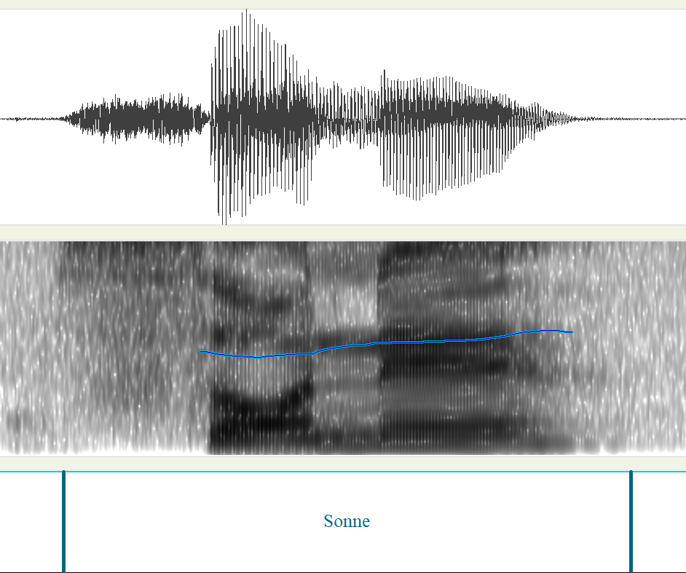
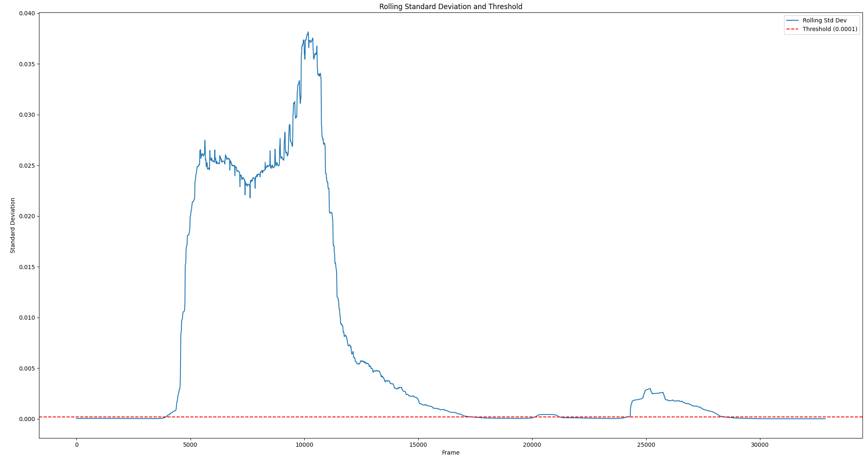
Audio Extraction
Webmouse labels used for rough guidance
Rolling std peformed whith threshold at 0.0002

Slide 4
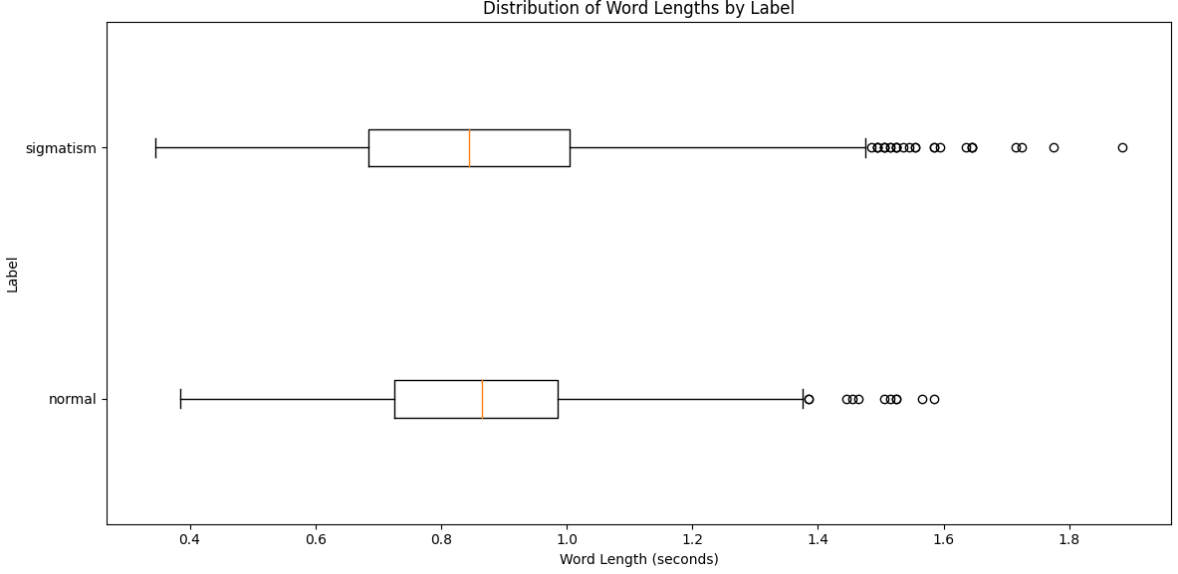
New length of words
Notes:
Man könnte sich noch einen low pass filter überlegen.
Outlier ab 1.5 mal angeschaut. Sind fast alles sigmatismus wörter. Aussprache teilweise sehr betont.

Slide 5
Normalization
Till now [-1,1] (Peak) Normalization but has some flaws
Use Mean-and-Variance Normalization per speaker (z-score)
Got global mean and std from training split
Applied that to each file for CPP,FAD.
- For MFCC and Mel specto:
Normalize only image with z-score. Avoid double normalization.
The STT takes the raw waveform
Notes:
[-1,1] (Peak) Normalization doesn not stabilize mean and variance
limiting to [−1,1] helps avoid clipping in fixed-point systems. But in deep learning it’s fine to have values outside [−1,1]
Potentially Harms Gradient Descent

Slide 6
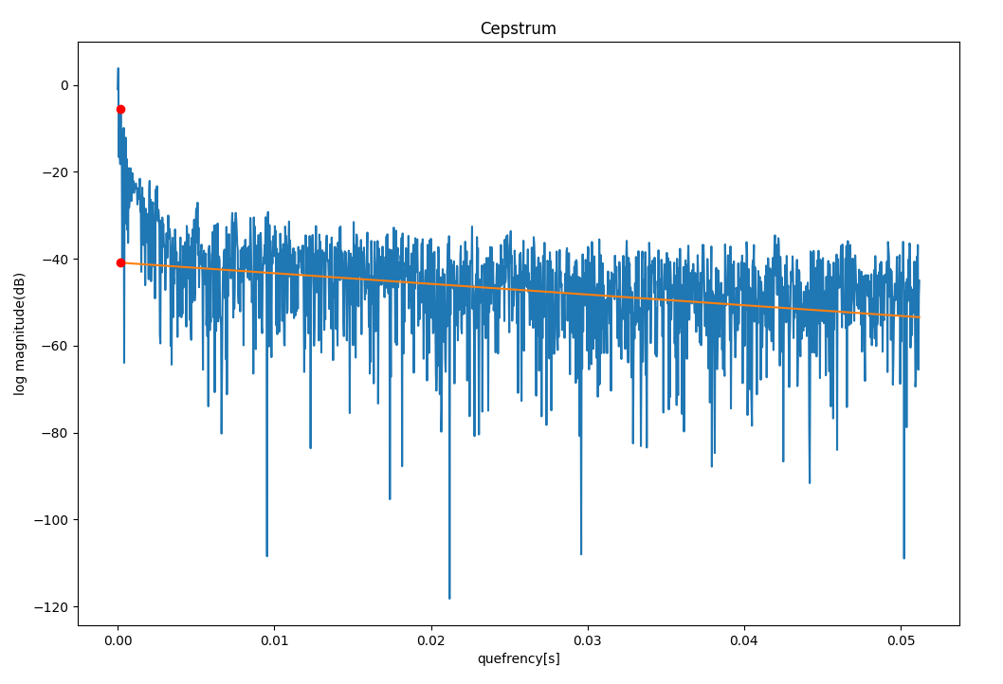
CPP – 16kHz

Slide 7
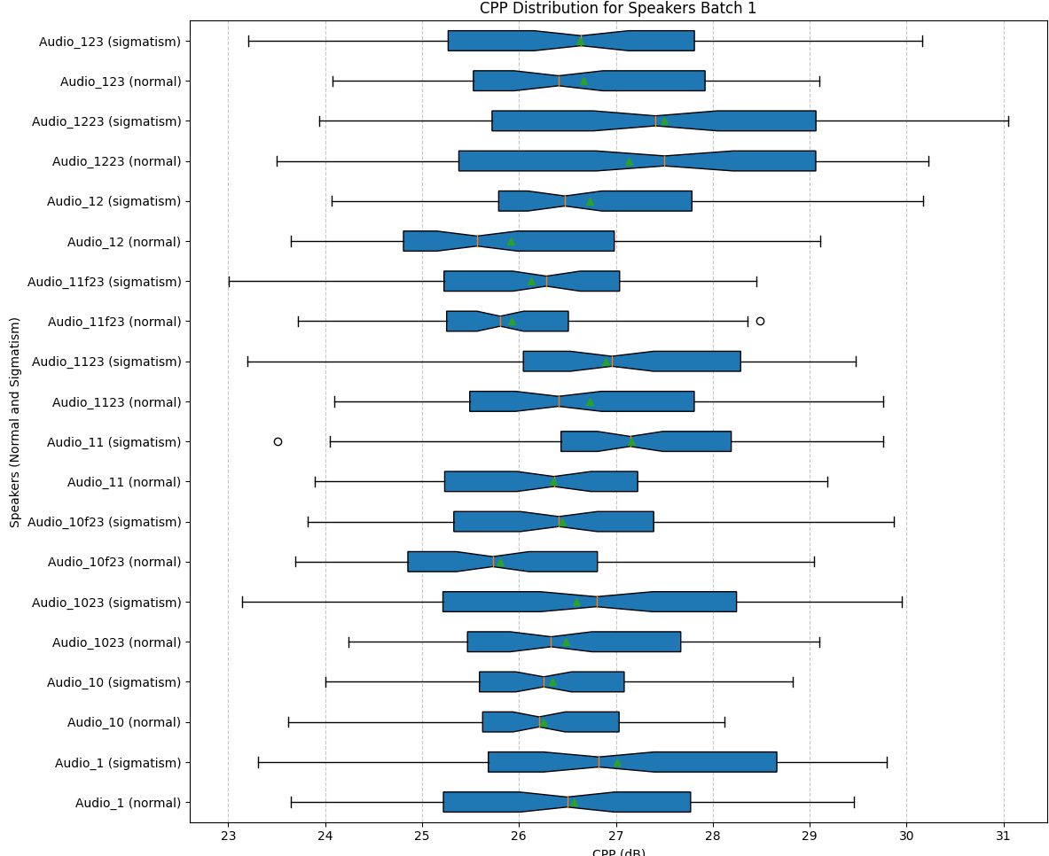
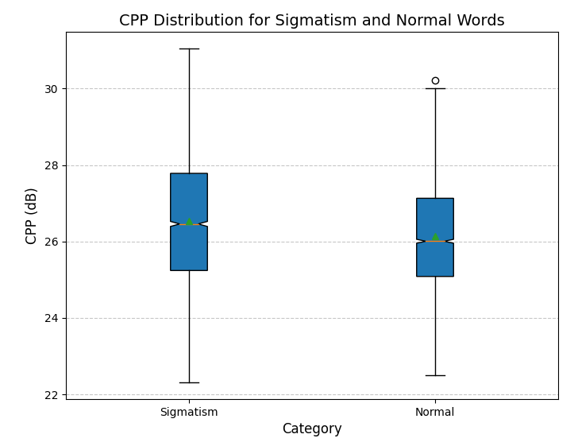
pitch_range=[60, 1000],
trendline_quefrency_range=[0.001, 0.05]

Slide 8
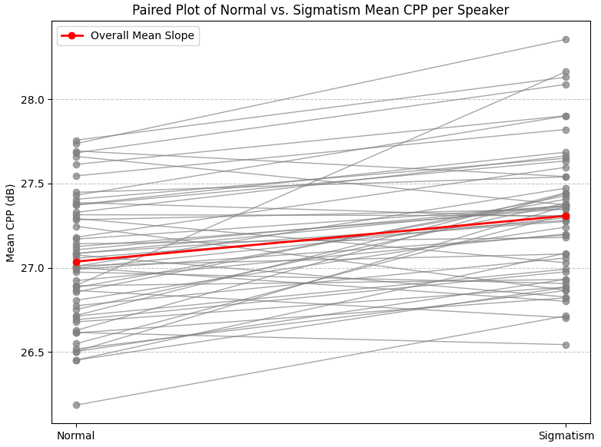
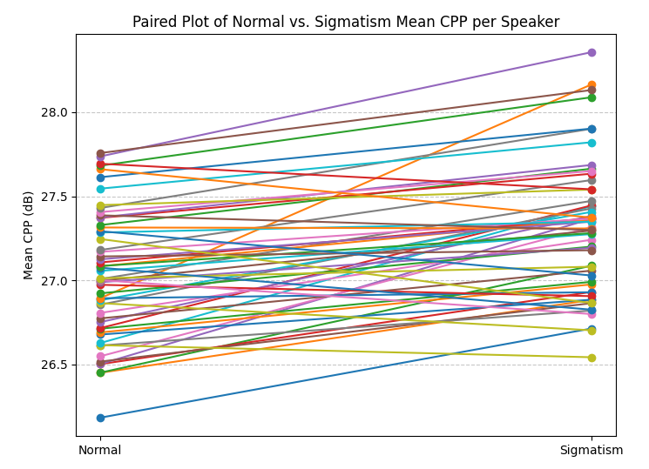
Paired T-test
pitch_range=[60, 1000],
trendline_quefrency_range=[0.001, 0.05]

Slide 9
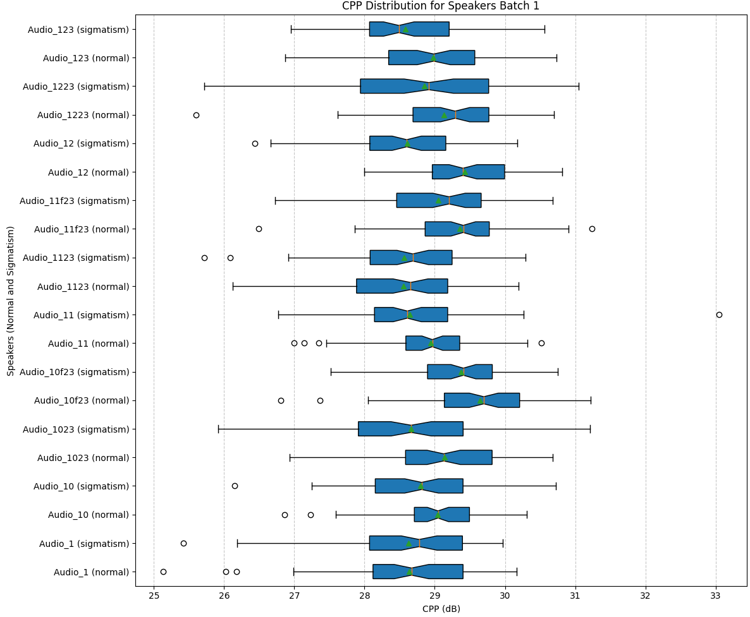
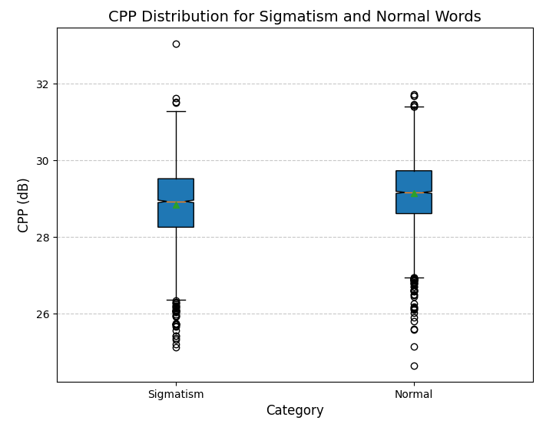
pitch_range=[60, 8000],
trendline_quefrency_range=[0.001, 0.05]

Slide 10
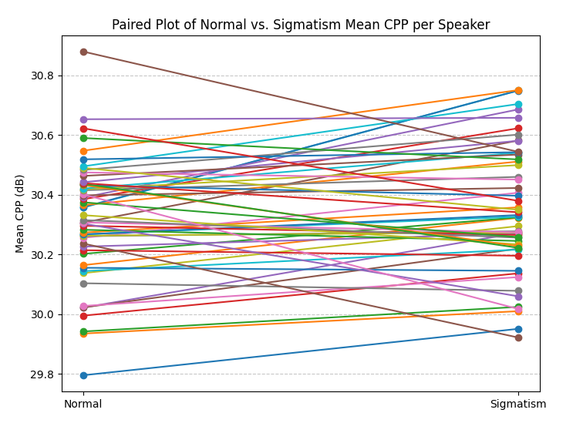
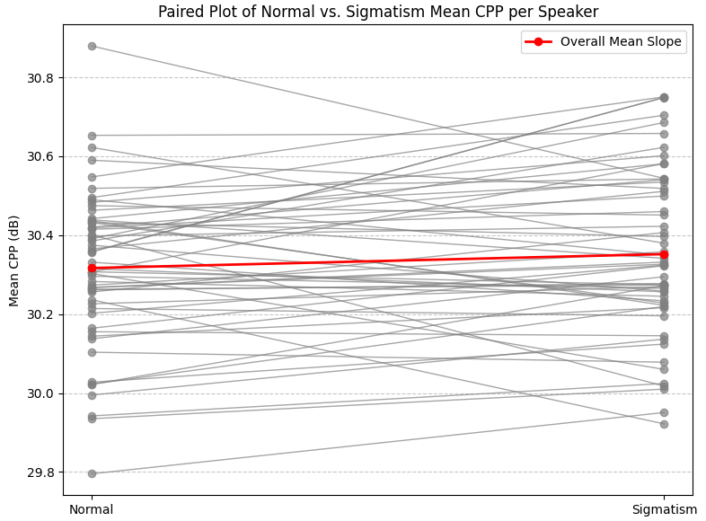
Paired T-test
pitch_range=[60, 8000],
trendline_quefrency_range=[0.001, 0.05]

Slide 11
FID/FAD
The FAD from the model is the same as before because it takes the raw audio folder: FAD score with model: 0.278
Compute mean and cov
FID = ||mu1 - mu2||^2 + Tr(sigma1 + sigma2 - 2 * sqrt(sigma1 * sigma2))
mu1, sigma1 : Mean vector and covariance of word 1
mu2, sigma2 : Mean vector and covariance of word 2
Was done for every word because cov otherwise too big.

Slide 12
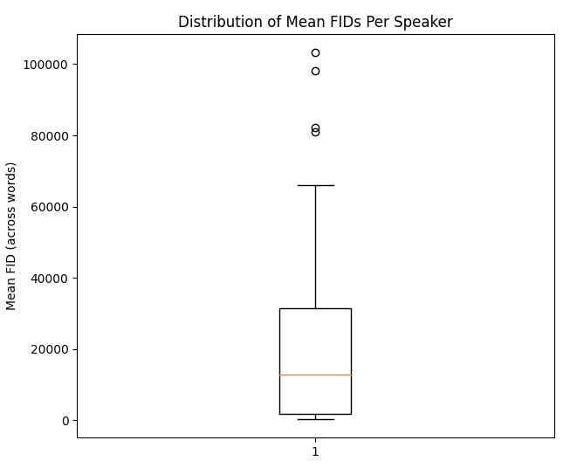
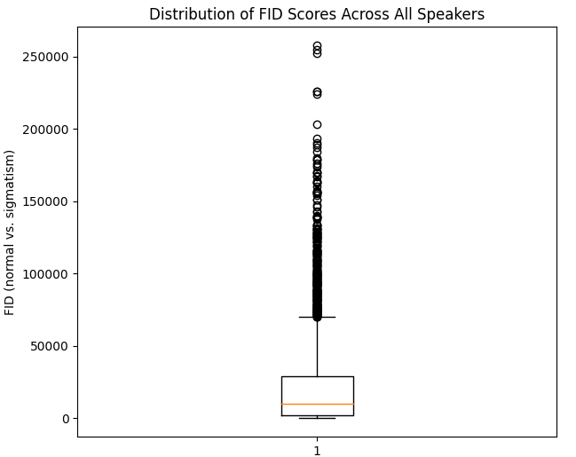

Slide 13
STT nodel
16kHz non normalized word segments used
ß was changed to s
Only if s,x or z are present in a word the AuC is computed

Slide 14
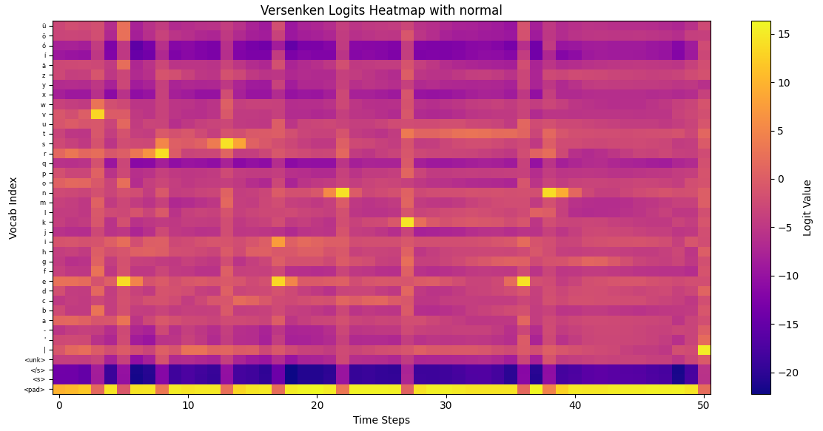
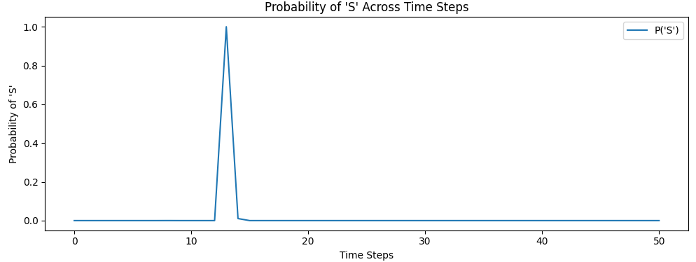
Reference: Versenken
Prediction: ['versenken’]
normal

Slide 15
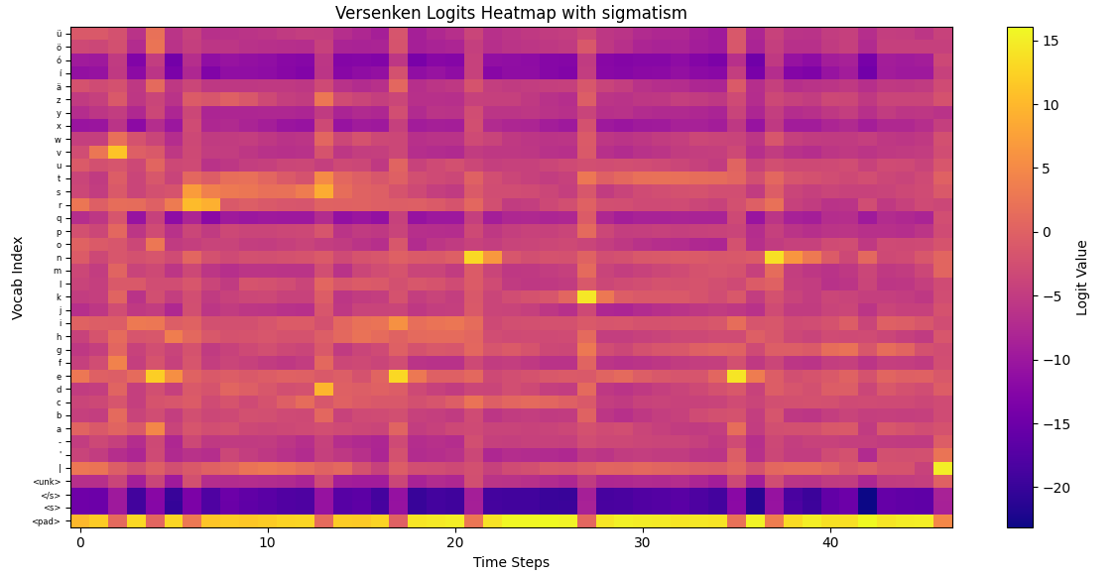
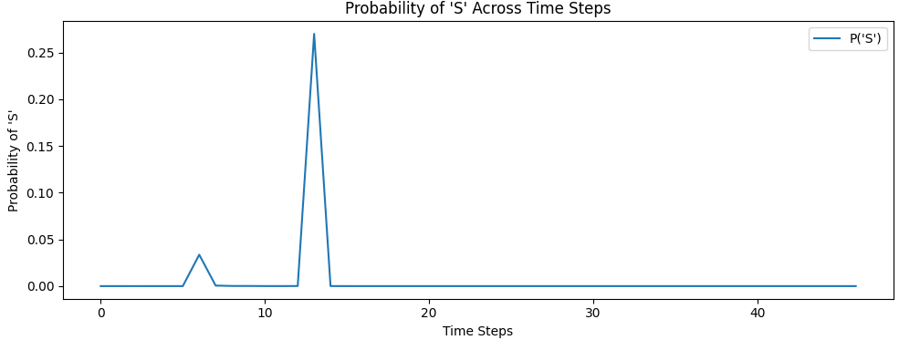
Reference: Versenken
Prediction: ['verdenken’]
sigmatism

Slide 16
